Slide 1
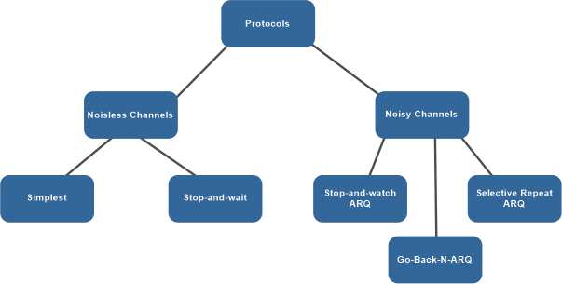
Data Link Layer Protocols

Slide 2
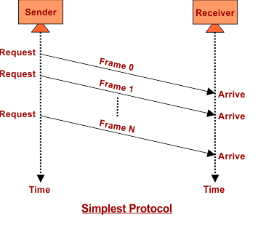
Data Link Layer Protocols-Simple

Slide 3
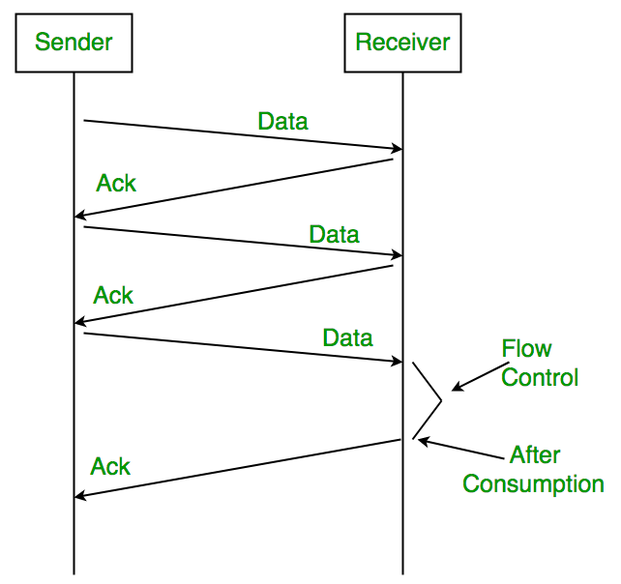
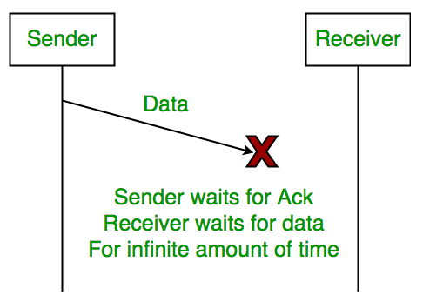
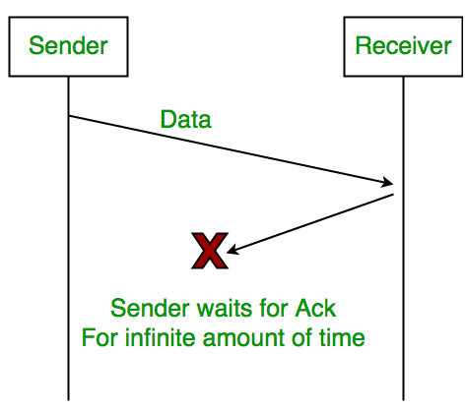
Data Link Layer Protocols
Stop and Wait

Slide 4
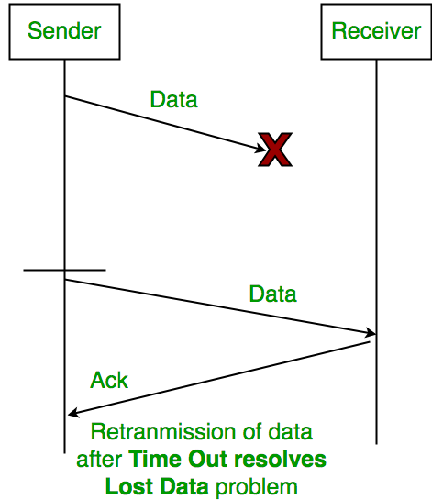
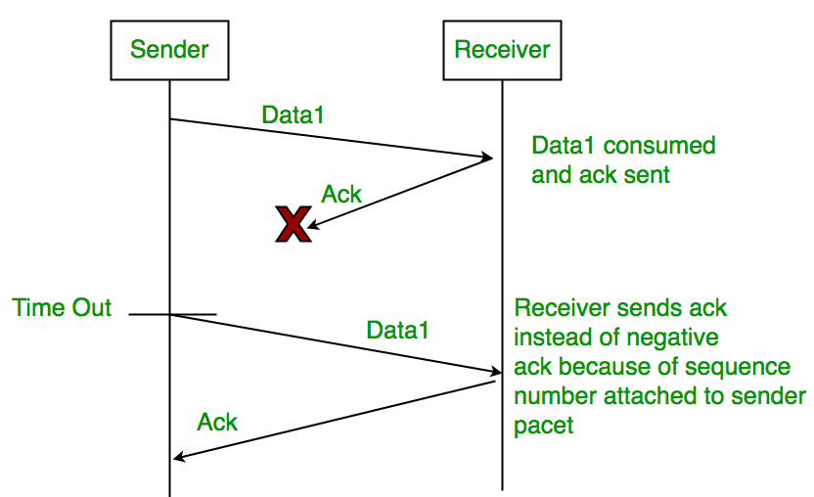
Data Link Layer Protocols
Stop and Wait Automatic Repeat Request

Slide 5
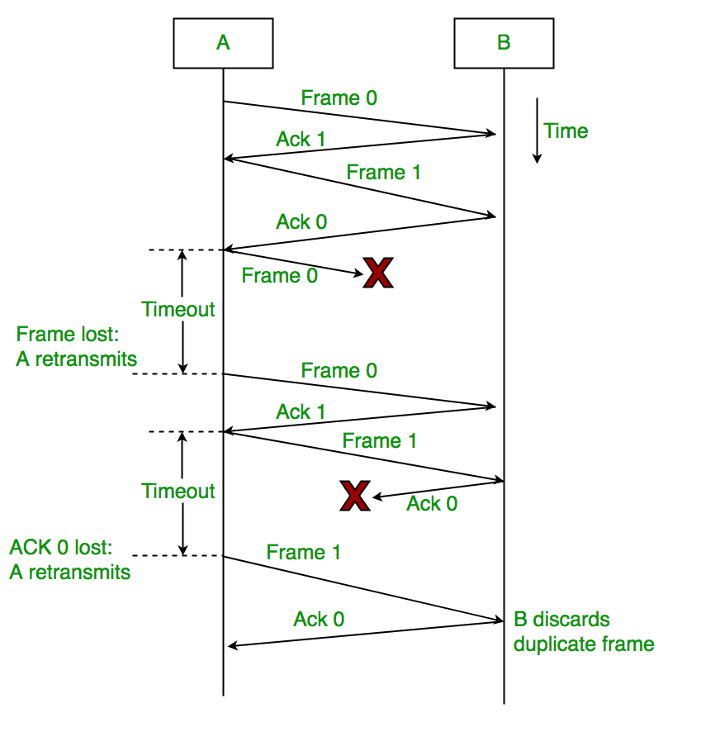
Data Link Layer Protocols
Stop and Wait ARQ

Slide 6
Data Link Layer Protocols
Characteristics of Stop and Wait ARQ
It uses a link between sender and receiver as a half-duplex link.
Throughput = 1 Data packet/frame per RTT
If the Bandwidth*Delay product is very high, then they stop and wait for protocol if it is not so useful.
The sender has to keep waiting for acknowledgements before sending the processed next packet.
It is an example of “Closed Loop OR connection-oriented “ protocols
It is a special category of SWP where its window size is 1
Irrespective of the number of packets sender is having stop and wait for protocol requires only 2 sequence numbers 0 and 1

Slide 7
Data Link Layer Protocols
Advantages of Stop and Wait ARQ:
Simple Implementation: Stop and Wait ARQ is a simple protocol that is easy to implement in both hardware and software. It does not require complex algorithms or hardware components, making it an inexpensive and efficient option.
Error Detection: Stop and Wait ARQ detects errors in the transmitted data by using checksums or cyclic redundancy checks (CRC). If an error is detected, the receiver sends a negative acknowledgment (NAK) to the sender, indicating that the data needs to be retransmitted.
Reliable: Stop and Wait ARQ ensures that the data is transmitted reliably and in order. The receiver cannot move on to the next data packet until it receives the current one. This ensures that the data is received in the correct order and eliminates the possibility of data corruption.
Flow Control: Stop and Wait ARQ can be used for flow control, where the receiver can control the rate at which the sender transmits data. This is useful in situations where the receiver has limited buffer space or processing power.
Backward Compatibility: Stop and Wait ARQ is compatible with many existing systems and protocols, making it a popular choice for communication over unreliable channels.

Slide 8
Data Link Layer Protocols
Disadvantages of Stop and Wait ARQ :
Low Efficiency: Stop and Wait ARQ has low efficiency as it requires the sender to wait for an acknowledgment from the receiver before sending the next data packet. This results in a low data transmission rate especially for large data sets.
High Latency: Stop and Wait ARQ introduces additional latency in the transmission of data, as the sender must wait for an acknowledgment before sending the next packet. This can be a problem for real-time applications such as video streaming or online gaming.
Limited Bandwidth Utilization: Stop and Wait ARQ does not utilize the available bandwidth efficiently, as the sender can transmit only one data packet at a time. This results in underutilization of the channel, which can be a problem in situations where the available bandwidth is limited.
Limited Error Recovery: Stop and Wait ARQ has limited error recovery capabilities. If a data packet is lost or corrupted, the sender must retransmit the entire packet, which can be time-consuming and can result in further delays.
Vulnerable to Channel Noise: Stop and Wait ARQ is vulnerable to channel noise, which can cause errors in the transmitted data. This can result in frequent retransmissions and can impact the overall efficiency of the protocol.

Slide 9
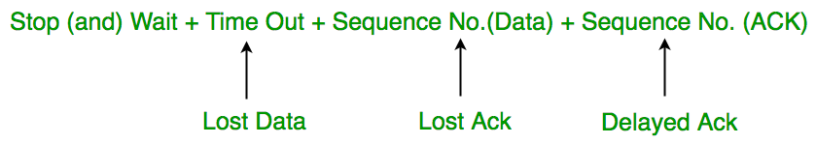
Data Link Layer Protocols
Quiz: Suppose two hosts are connected by a point-to-point link and they are configured to use Stop and Wait protocol for reliable data transfer. Identify in which one of the following scenarios, the utilization of the link is the lowest.
(A) Longer link length and lower transmission rate
(B) Longer link length and higher transmission rate
(C) Shorter link length and lower transmission rate
(D) Shorter link length and higher transmission rate

Slide 10
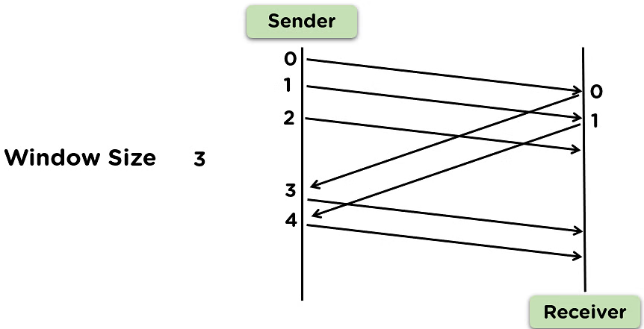
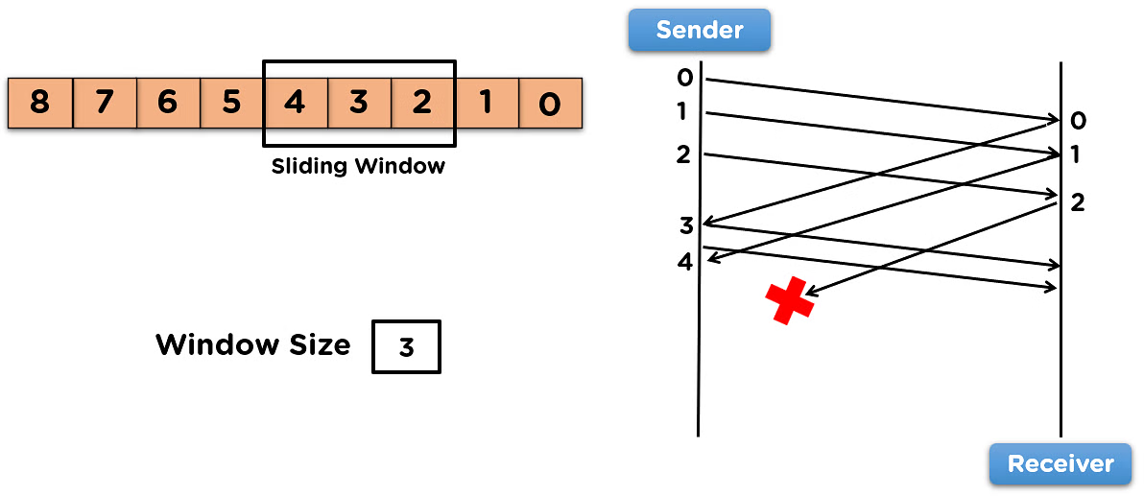
Data Link Layer Protocols
Go-Back-N ARQ

Slide 11
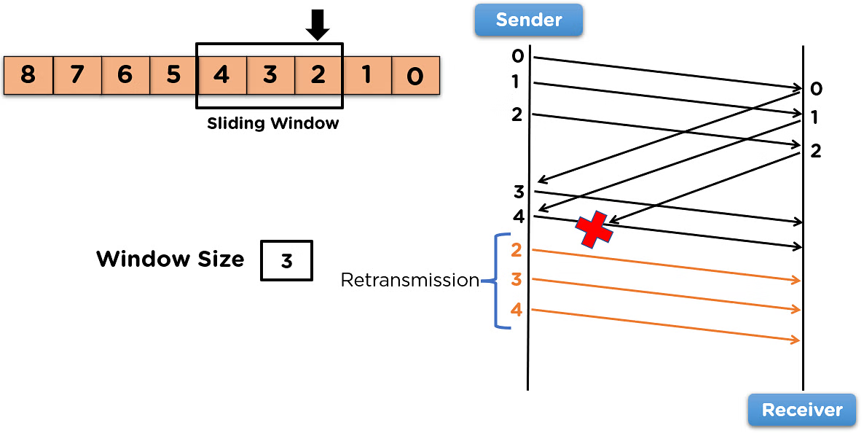
Data Link Layer Protocols
Go-Back-N ARQ

Slide 12
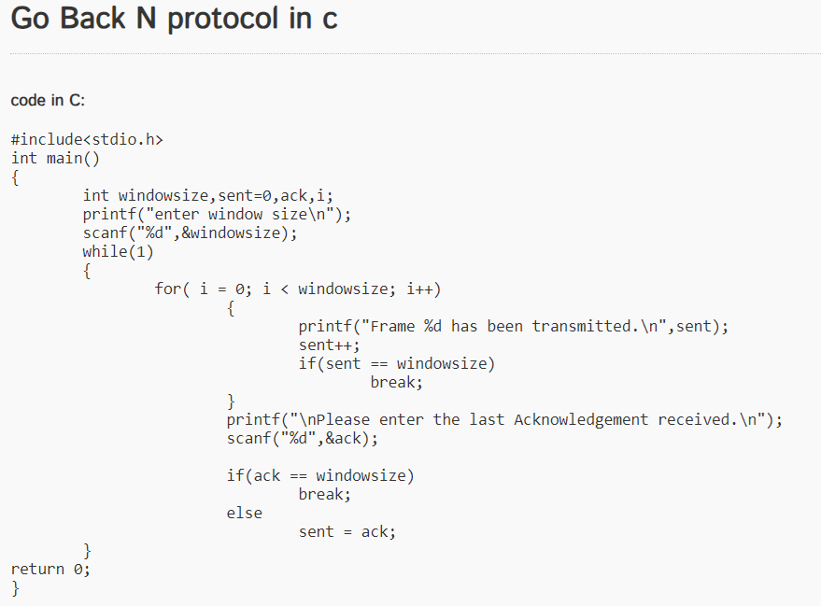
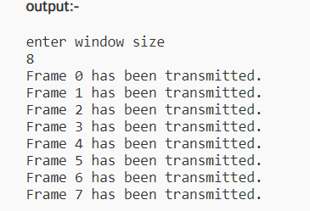
Data Link Layer Protocols
Go-Back-N ARQ

Slide 13
Data Link Layer Protocols
Go-Back-N ARQ
Advantages :
Multiple frames can be simultaneous to the receiver side.
Increase the efficiency of the data transfer and has more control over the flow of frames.
Time delay is less for sharing data frames.
Disadvantages:
The storage of data frames at the receiver side.
Retransmission of frames, when the acknowledgement is not received by the sender end.

Slide 14
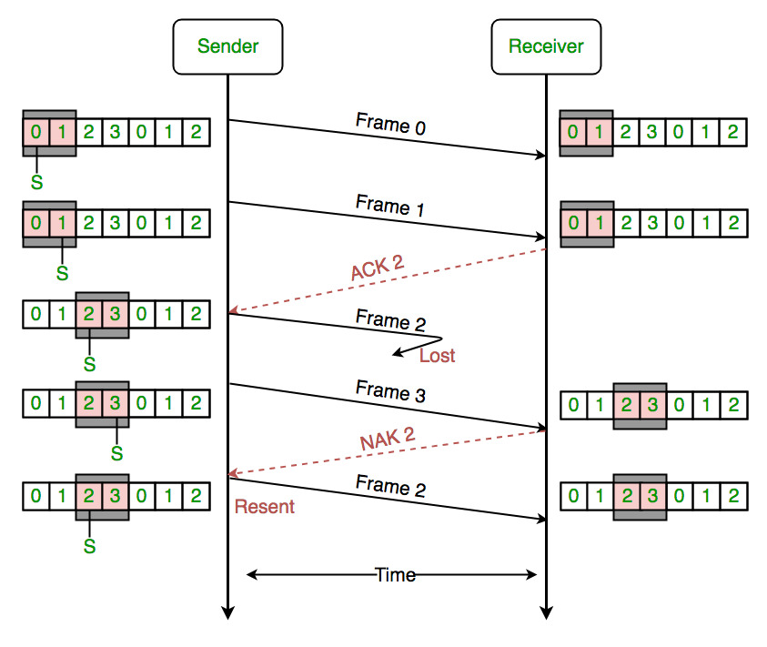
Data Link Layer Protocols
Selective Repeat Protocol

Slide 15
Data Link Layer Protocols
Selective Repeat Protocol
Selective Repeat Protocol (SRP) : This protocol(SRP) is mostly identical to GBN protocol, except that buffers are used and the receiver, and the sender, each maintains a window of size.
SRP works better when the link is very unreliable. Because in this case, retransmission tends to happen more frequently, selectively retransmitting frames is more efficient than retransmitting all of them.
SRP also requires full-duplex link. Backward acknowledgements are also in progress.
Sender’s Windows ( Ws) = Receiver’s Windows ( Wr).
Window size should be less than or equal to half the sequence number in SR protocol. This is to avoid packets being recognized incorrectly.
If the size of the window is greater than half the sequence number space, then if an ACK is lost, the sender may send new packets that the receiver believes are retransmissions.
Sender can transmit new packets as long as their number is with W of all unACKed packets.
Sender retransmit un-ACKed packets after a timeout – Or upon a NAK if NAK is employed.
Receiver ACKs all correct packets.
Receiver stores correct packets until they can be delivered in order to the higher layer.
In Selective Repeat ARQ, the size of the sender and receiver window must be at most one-half of 2^m.

Slide 16
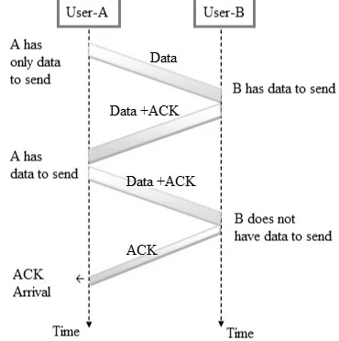
Data Link Layer Protocols
Piggybacking
Piggybacking is a protocol designed to optimize network bandwidth usage.
It involves delaying acknowledgments until no data frames are available for transfer.
This approach efficiently utilizes available bandwidth by attaching acknowledgments to the data frames being transmitted.

Slide 17
Data Link Layer Protocols
Piggybacking
Benefits or Advantages of Piggybacking :
It increases network efficiency by combining multiple types of data or control information into a single packet.
This reduces number of packets on the network which saves bandwidth and reduces overload load on the network.
It reduces latency in delivering data and acknowledgments. The low latency is essential in real time and interactive applications.
It can help in conserving network resources such as bandwidth and processing power. This is important in resource constrained environments.

Slide 18
Data Link Layer Protocols
Piggybacking
Disadvantages of Piggybacking:
Piggybacking implementation adds complexity to network protocols and systems.
While it can reduce latency in some cases, it can introduce delays if control information is held back to be piggybacked on later packet. This will be troublesome if control information is time sensitive.
When multiple types of information are combined in a single packet, error handling becomes more complex. If an error occurs in part of packet, it affects entire packet including unrelated data.
It may not be supported or handled correctly by all network devices and protocols which may lead to compatibility issues.
Though it can reduce overhead in many situations, in some cases, it might actually increase overhead if control information is extensive or if it results in larger packets that require fragmentation.

Slide 19
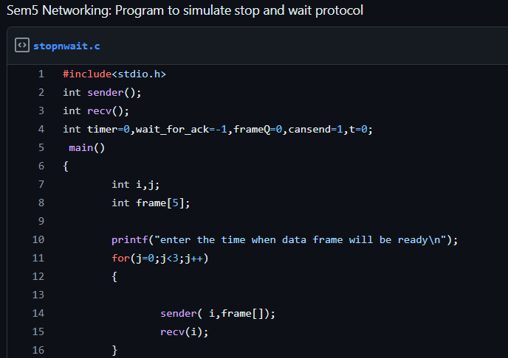
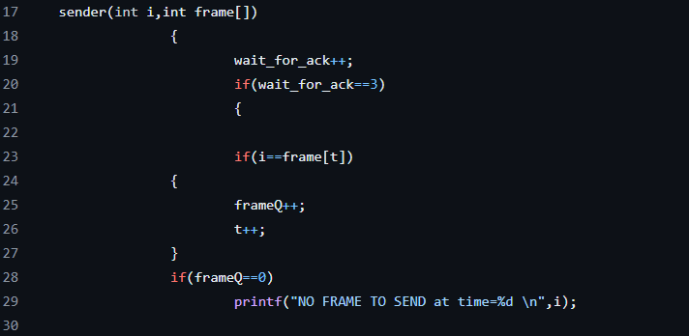
Data Link Layer Protocols
Stop and Wait

Slide 20
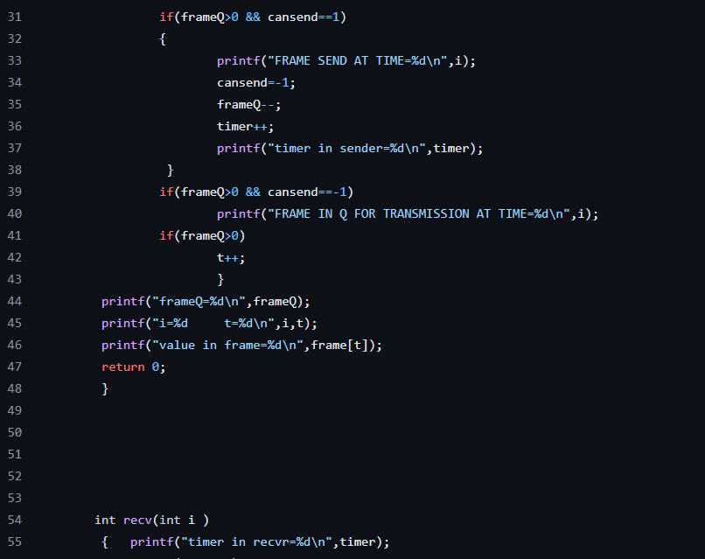
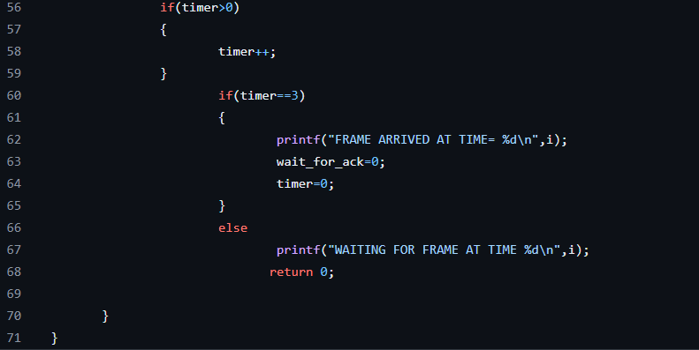
Data Link Layer Protocols
Stop and Wait

Slide 21
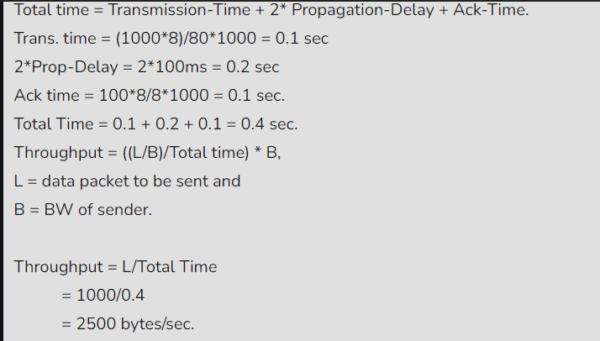
Data Link Layer Protocols
Stop and Wait
Quiz2. A sender uses the Stop-and-Wait ARQ protocol for reliable transmission of frames. Frames are of size 1000 bytes and the transmission rate at the sender is 80 Kbps (1Kbps = 1000 bits/second). Size of an acknowledgement is 100 bytes and the transmission rate at the receiver is 8 Kbps. The one-way propagation delay is 100 milliseconds. Assuming no frame is lost, the sender throughput is __________ bytes/second.
(A) 2500
(B) 2000
(C)1500
(D) 500
500

Slide 22
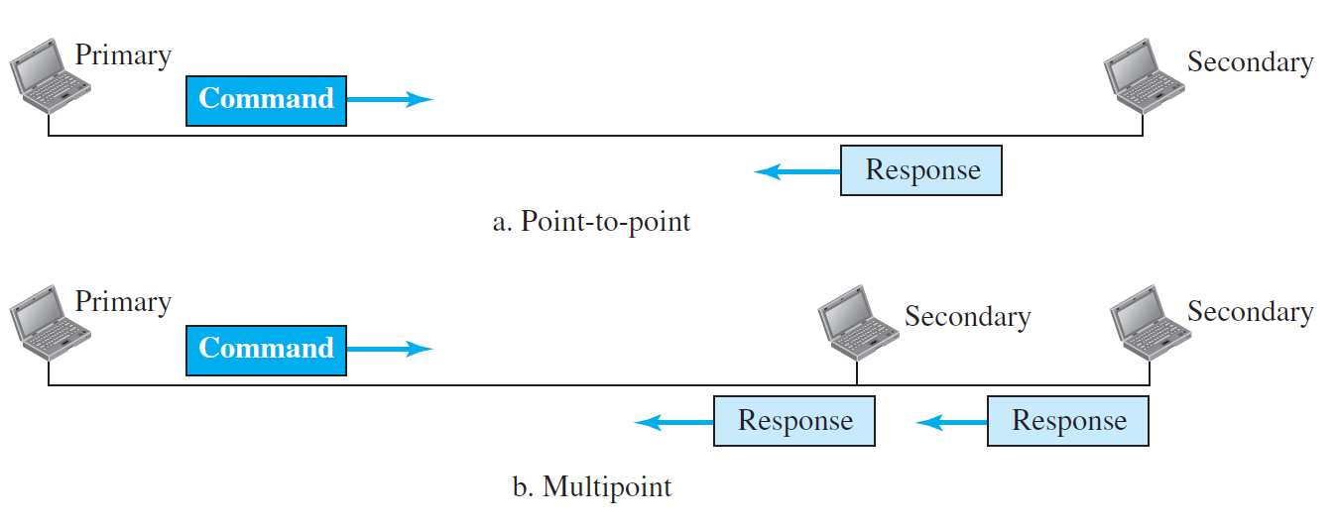
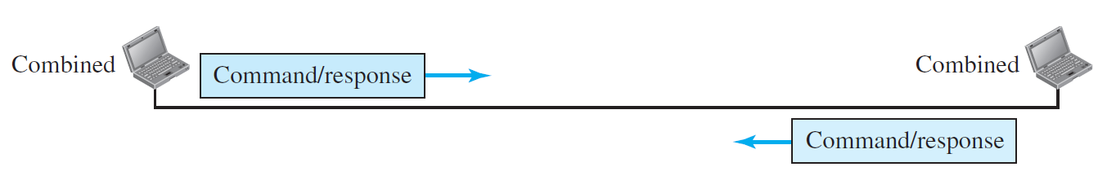
HDLC: High Level Data Link Control
High-level Data Link Control (HDLC) is a bit-oriented protocol for communication over point-to-point and multipoint links.
High-Level Data Link Control (HDLC) is a communication protocol used for transmitting data between devices in telecommunication and networking.
Developed by the International Organization for Standardization (ISO), it is defined in the standard ISO / IEC (International Electrotechnical Commission) 13239:2002.
It uses Stop-and-wait protocol.
Configuration and Transfer modes: Two transfer modes that can be used in different configurations.
Normal Response Mode (NRM): The station configuration is unbalanced. We have one primary station and multiple secondary stations. A primary station can send commands; a secondary station can only respond. The NRM is used for both point-to-point and multipoint links
Asynchronous Balanced mode (ABM): The configuration is balanced. The link is point-to-point, and each station can function as a primary and a secondary (acting as peers).
500

Slide 23
HDLC- Framing
High-level Data Link Control (HDLC) is a group of communication protocols of the data link layer for transmitting data between network points or nodes.
Since it is a data link protocol data is organized into frames.
A frame is transmitted via the network to the destination that verifies its successful arrival.
It is a bit - oriented protocol that is applicable for both point - to - point and multipoint communications.
500

Slide 24
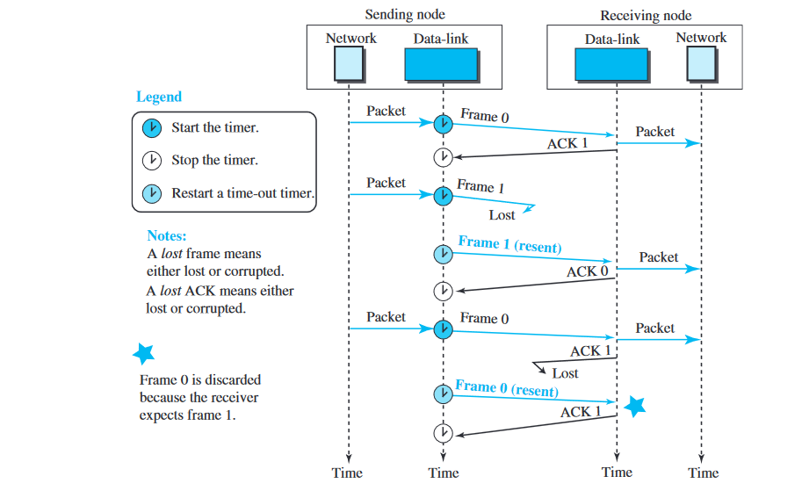
HDLC- Framing
500

Slide 25
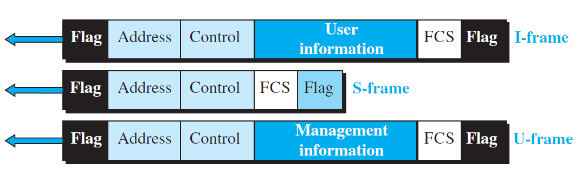
HDLC- Framing
Three types of frames:
Information frames (I-frames): Data-link user data and control information relating to user data (piggybacking). The first bit of control field of I-frame is 0.
Supervisory frames (S-frames): They are used for flow and error control when piggybacking is not required. Used only to transport control information. The first two bits of control field of S-frame is 10.
Unnumbered frames (U-frames): Un-numbered frames are used for myriad miscellaneous functions, like link management. It may contain an information field, if required. The first two bits of control field of U-frame is 11.
500

Slide 26
HDLC- Framing
Flag field: Has synchronization pattern 01111110, which identifies both the beginning and the end of a frame.
Address field: This field contains the address of the secondary station. If a primary station created the frame, it contains a ‘to’ address. If a secondary station creates the frame, it contains a ‘from’ address.
Control field: The control field is one or two bytes used for flow and error control. It determines the type of the frame.
Information field: It contains the user’s data from the network layer or management information. Its length can vary from one network to another.
FCS field: The frame check sequence (FCS) is the HDLC error detection field. It can contain either a 2- or 4-byte CRC.
500

